Slide 1

Mental Health Prediction
using transformers
Team members:
Abdallah Ahmed Abdallah
Abdallah Hesham Gomaa
Abdelrahman Karam Mahmoud
Abdelrahman Mohamed Talat
Abd-elfatah Ahmed Abd-elfatah
Omar Ramadan Nabeh
4 May, 2025
Under Supervision of:
Eng/ Mariam Mahmoud

Slide 2

Problem statement
Mental health disorders impact all ages worldwide but remain underprioritized in healthcare, education, and workplaces. Conditions like depression, anxiety, and stress affect emotional well-being, cognition, and quality of life, reducing productivity, harming relationships, and increasing healthcare costs. Stigma, limited service access, and poor education deepen the crisis, leaving many untreated. Addressing mental health is both a humanitarian and economic imperative.

Slide 3

About Dataset
About dataset
We used an open-source dataset from kaggle,
the dataset is about classification of text for 7 different classes
Dataset classes
Normal
Depression
Suicidal
Anxiety
Stress
Bi-Polar
Personality Disorder

Slide 4
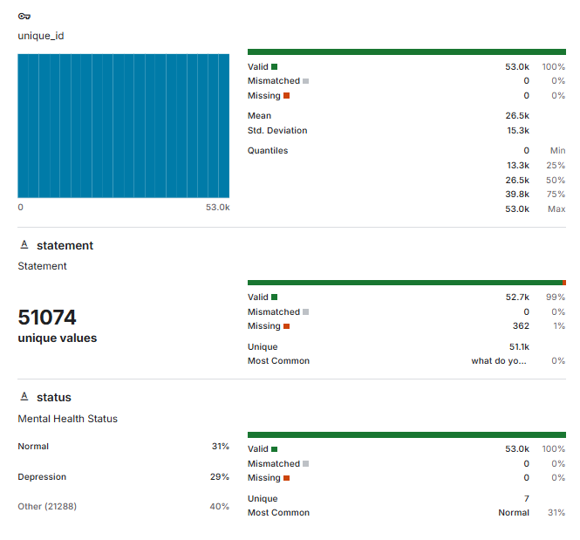
About Dataset (contd.)
Number of rows
this dataset contains ~ 53.0k rows
Description
unique_id column was not important an important feature, so we removed it.
statement and status was the input and output for the model

Slide 5
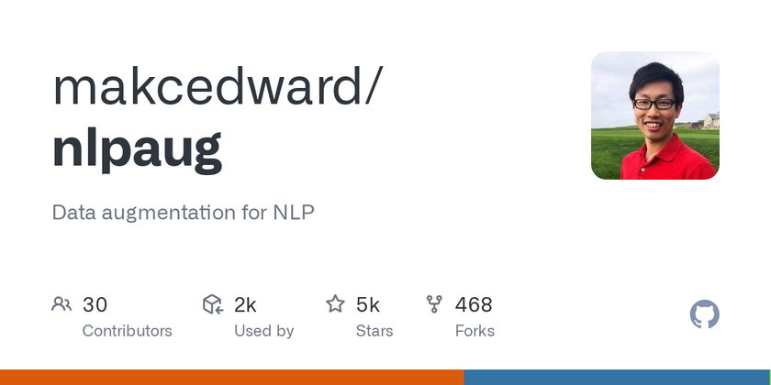
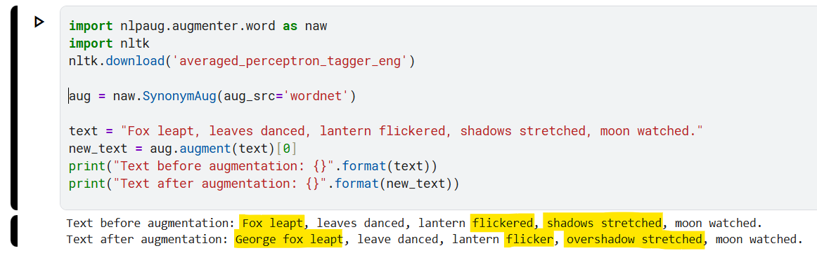
Data Augmentation
We used nlpaug.augmentor.word from makcedward

Slide 6
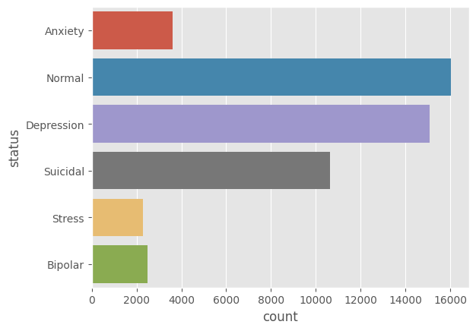
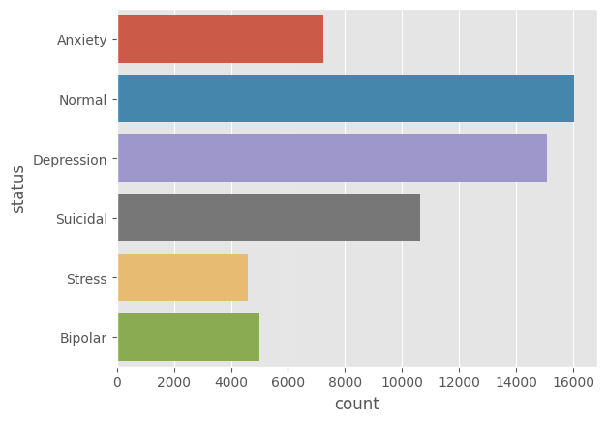
Data Augmentation (contd.)
classes count before augmentation
classes count after augmentation

Slide 7


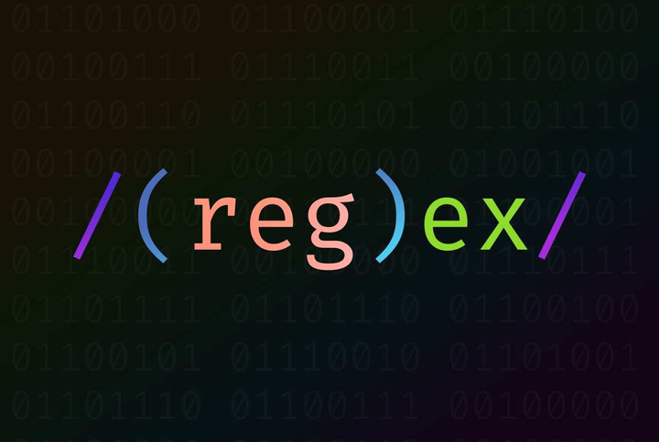
Dataset cleaning and preprocessing
Python
We used pandas in python to preprocess the data in a form of DataFrames
Cleaning done
tokenization
remove punctuation
remove dots
remove stop words
stemmer
lemmatization
remove hyperlinks
remove tags
9.remove nulls (362)
10.remove duplicates (1588)

Slide 8
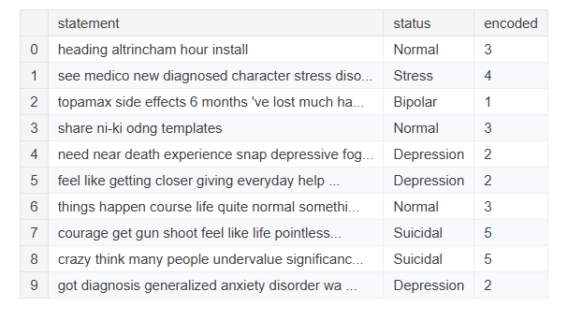
Final shape of the data

Slide 9
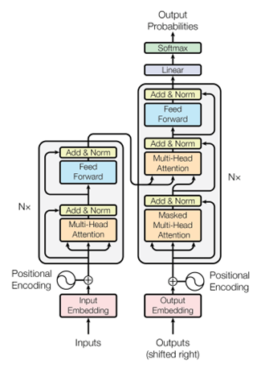
BERT Transformer
Introduction
BERT (Bidirectional Encoder Representations from Transformers) is a state-of-the-art language representation model developed by Google in 2018
Key Components
Transformer + self-attention
Bidirectional (reads both ways)
Pretrained with MLM + NSP
Input: [CLS] + sentence(s) + [SEP]
Uses embeddings (token, segment, position)
Fine-tunes easily for tasks

Slide 10
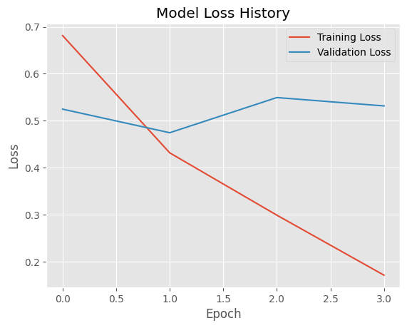
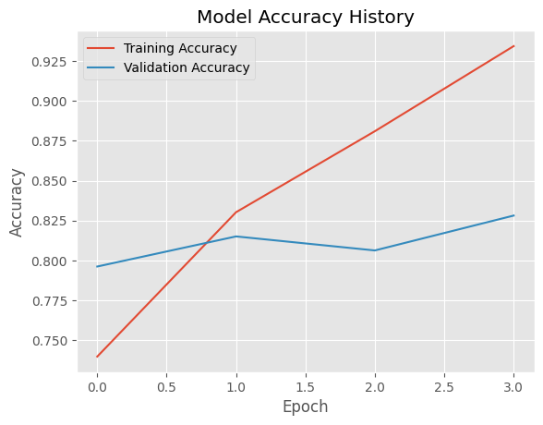
Model Evaluation Metrics

Slide 11
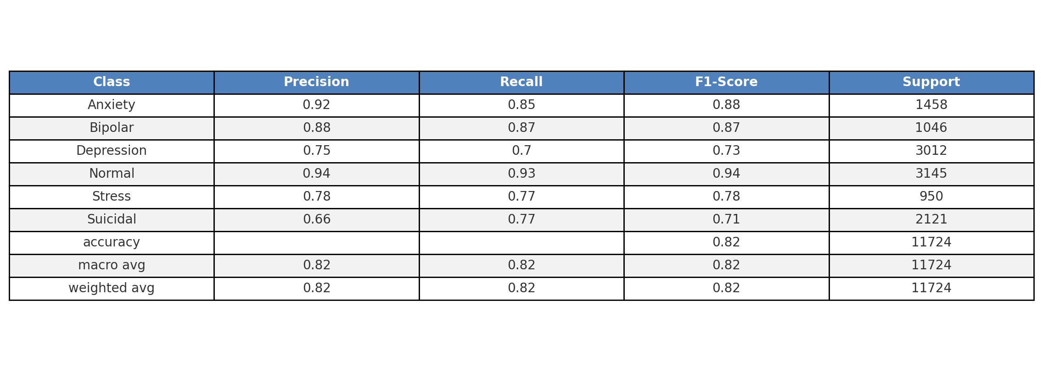
Model Evaluation Metrics (contd.)

Slide 12
Thank you

